Slide 1
How to create a Dashboard Prompt
Yoel Kortick
Senior Librarian

Slide 2
Introduction
Creating the dashboard prompt
Adding the dashboard prompt to the dashboard
Running the dashboard with the dashboard prompt

Slide 3
Introduction
It is possible to create prompts
Per report
For an entire dashboard
When several reports are in a dashboard, and it is likely that the user will want to filter all reports by the same parameter, it is more efficient to use one dashboard prompt rather than a separate prompt on each report.

Slide 4
Introduction
For example a dashboard which contains several reports relating to orders, funds, transactions etc. might have one prompt for “Fiscal period”
In this way the user can choose the prompt value once and it will relate to all reports on all pages of the dashboard.
This is more efficient than having the user choose a prompt each time she or he views a report on a different page of the dashboard.

Slide 5
Introduction
In the example here we will use a dashboard called “Physical Item Loans Dashboard”.
This dashboard was created as described in How to create a new Analytics Dashboard
It has three pages (tabs).
We will add one prompt to filter by borrower user group for all three pages

Slide 6
Creating the dashboard prompt

Slide 7
Creating the dashboard prompt
We will now
Create the dashboard prompt via “Create > Dashboard Prompt”
Save it in folder “Prompts” under folder “Physical Item Loans”
Call it “Physical Item Loans Dashboard Prompt”

Slide 8
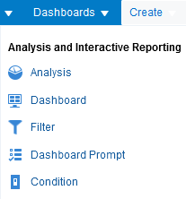
Creating the dashboard prompt

Slide 9
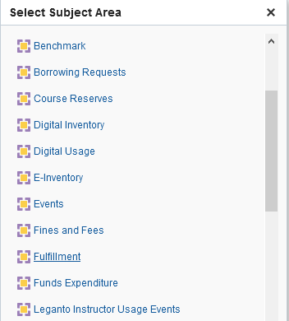
Creating the dashboard prompt
After selecting “Create > Dashboard Prompt” the user is prompted to select a subject area. We will choose “Fulfillment”.

Slide 10
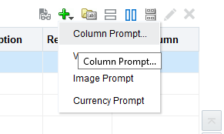
Creating the dashboard prompt
Add a column prompt

Slide 11
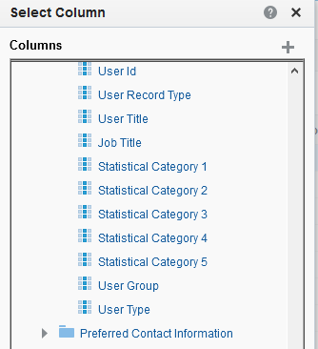
Creating the dashboard prompt
We will choose “Borrower Details > User Group” because that is what we want the prompt to filter by

Slide 12
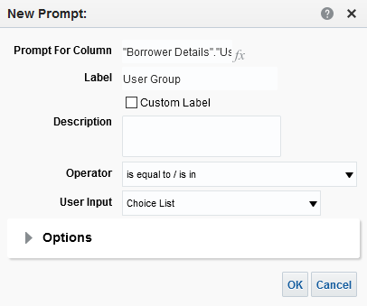
Creating the dashboard prompt
This appears

Slide 13
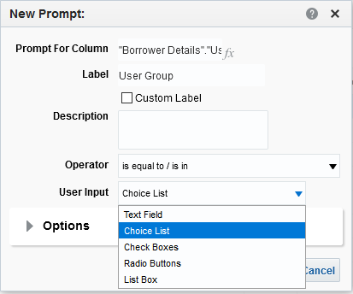
Creating the dashboard prompt
We will choose “Operator is equal to / is in” and “User Input Choice List”
We will click here for more options

Slide 14
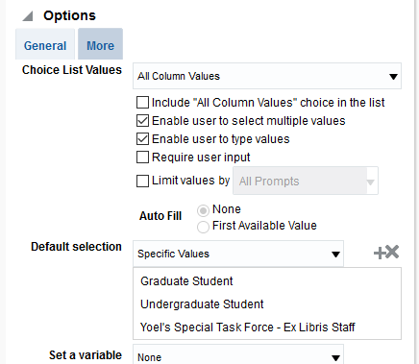
Creating the dashboard prompt
After clicking “Options” we have chosen as follows:
User can select multiple values
User can manually type in the values
Using the prompt is not required
These will be the default values

Slide 15
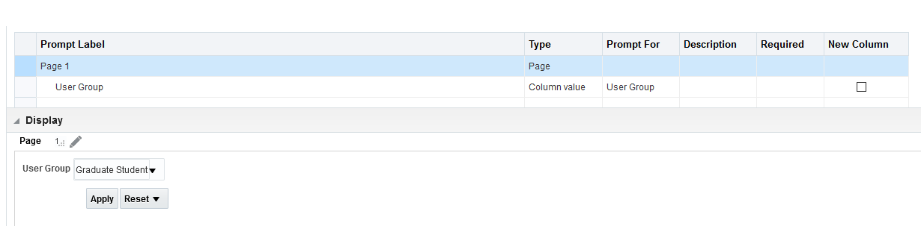
Creating the dashboard prompt
We can see how the prompt will appear

Slide 16

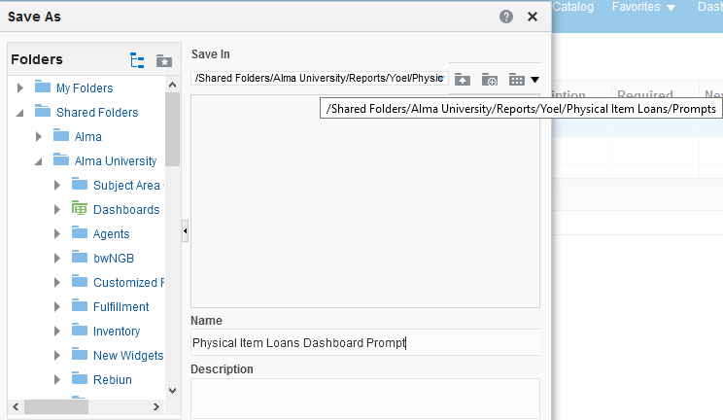
Creating the dashboard prompt
Save to directory “Physical Item Loans/Prompts”

Slide 17
Adding the dashboard prompt to the dashboard

Slide 18
Adding the dashboard prompt to the dashboard
There are two stages to adding the dashboard prompt to the dashboard:
In the reports of the dashboard select a filter on the field (in this case “Borrower Details > User Group” ) and define as “is prompted”
Add the prompt to the pages of the dashboard

Slide 19
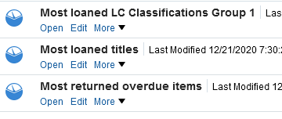
Adding the dashboard prompt to the dashboard
These are the reports in the dashboard. We will edit them and add the “Borrower Details > User Group” to be prompted

Slide 20
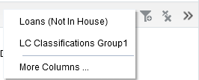
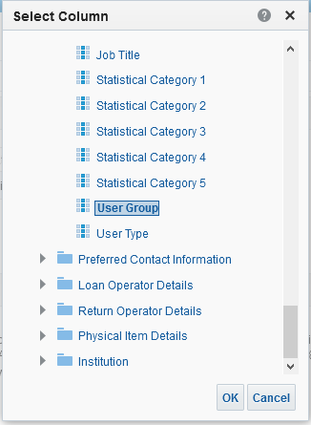
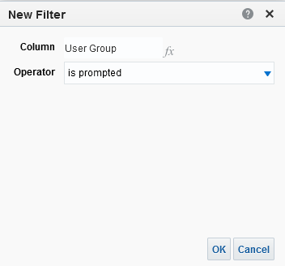
Adding the dashboard prompt to the dashboard
1.
2.
3.

Slide 21
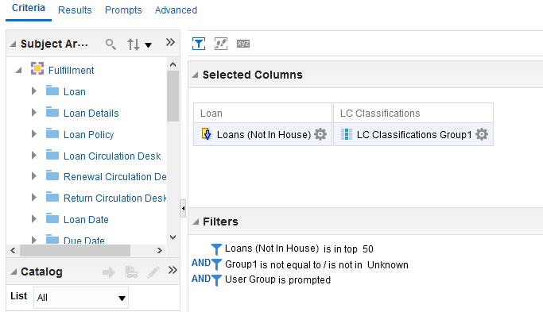
Adding the dashboard prompt to the dashboard
Now the dashboard reports have the user group as “is prompted”.

Slide 22
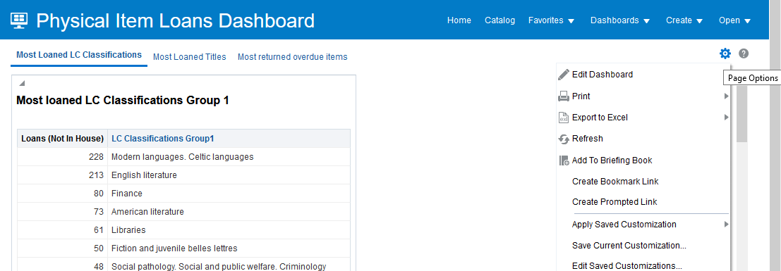
Adding the dashboard prompt to the dashboard
Now that the dashboard reports have the user group as “is prompted” we need to edit the pages of the dashboard and add the prompt

Slide 23
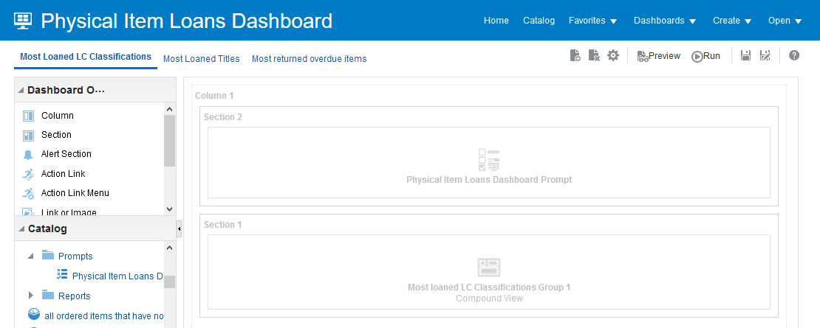
Adding the dashboard prompt to the dashboard
Drag the prompt in to each page

Slide 24
Running the dashboard with the dashboard prompt

Slide 25

Running the dashboard with the dashboard prompt
Now that we have done as follows:
  In the reports of the dashboard we selected a filter on the field (in this case “Borrower Details > User Group” ) and defined as “is prompted”
  Added the prompt to the pages of the dashboard
We can open the dashboard and test it out

Slide 26
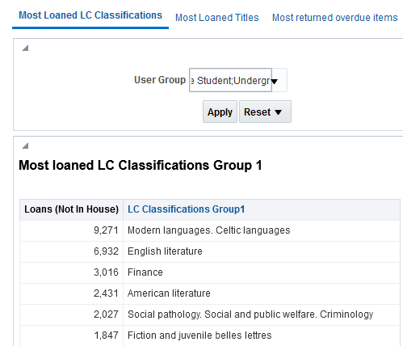
Running the dashboard with the dashboard prompt
Here is page “Most Loaned LC Classifications” with the dashboard prompt defaults
These results reflect the filters in the prompt

Slide 27
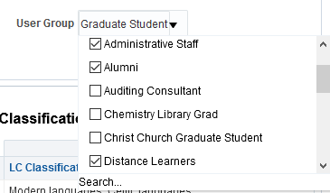
Running the dashboard with the dashboard prompt
Now we will instead choose “Administrative Staff”, “Alumni” and “Distance Learners”

Slide 28
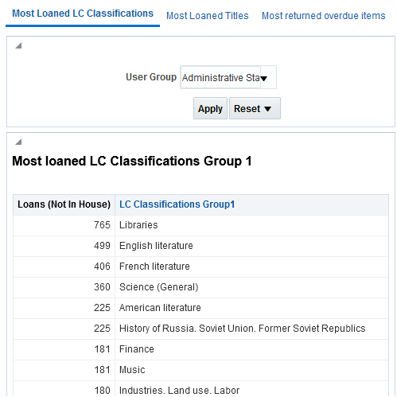
Running the dashboard with the dashboard prompt
The results have changed. The prompt works.
Results differ from default prompt values

Slide 29
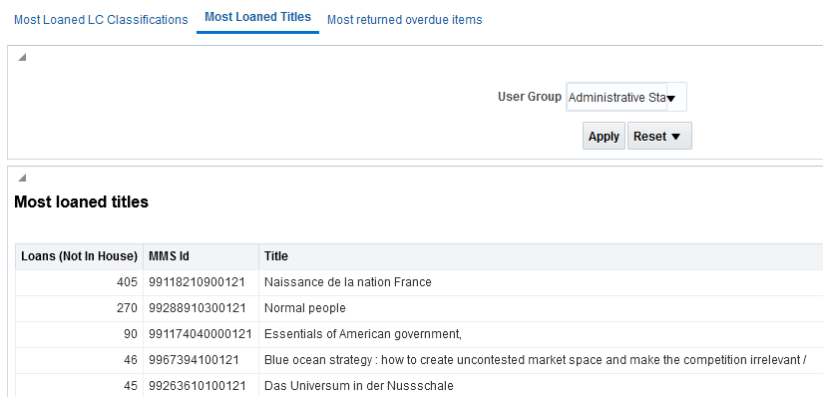
Running the dashboard with the dashboard prompt
As we switch tabs the prompt remains chosen and active in the pages. There is no need to choose the prompt each time (convenient and time saving).

Slide 30
Thank you!
xxx@exlibrisgroup.com

